Slide 1
User Research Findings
Due 10/5/21

Slide 2
User Interview - Brendan O’Brien, 19,
Main Method of transportation: walking, train, subway, car
Position:
He appreciates the walkability in city & public transportation because it allows him to lessen environmental impact.
He believes that transportation has a huge impact on the environment and this needs to be fixed.
Awareness on climate change should be raised with well-researched and digestible information
Action towards climate change will be made by the government and not on an individual basis.
Believes most changes to climate change will be made in a higher government level, not by him. But still recycles, limits water usage & carbon footprint
Thoughts on Climate Change:
“Certainly a problem that needs to be addressed”
“We are currently seeing the repercussions of Climate Change, even all around us with the increase in natural disasters around us (US NorthEast)
“Absolutely interested in alternative green transport - should be similar time commitment as a car though”

Slide 3
User Interview - Brandon Bolden, 21
Main Method of Transportation: SEPTA - subway, bus, car
Position:
Would appreciate consistency in scheduling of public transportation, cleaner, and fair pricing
His use of public transportation has a better impact than use of rental cars
Would be interested in a greener commute.
Sees the effects of Climate Change and pollution and sees no other option.
We need more education regarding climate change
More people should think about the long term of their actions
Thoughts on Climate Change:
He continuously hears about new records in weather disasters, and extinction of animals and fears for the future.
Believes there is no reason not to recycle

Slide 4
User Interview - Kalyani Ghuge, 21
Main Method of Transportation: Walking, subway, bicycles
Position:
Enjoys walking and using public transportation.
Wants to have a car in the future because of plans to live in more rural areas
Would take public transportation if it was more convenient for kids and baggage
Uses a bike, but would still appreciate accessible areas for bike upkeep.
Thoughts on Climate Change:
Climate change is “affecting quite a lot of resources that could be useful to us”
As a bioengineering major she would have a lot of job opportunities to work against climate change.
Realizes the danger of living on the coast with rising water levels and disasters.
Aware that private transportation worsens climate change but is against shaming people for using it
Interested in alternative methods of transportation as long it is cheap & doesn’t take too much effort
“We already have awareness about climate change, especially with millennials and Gen Z, but there are some people that don’t believe in it. Which is shocking to me.”

Slide 5
User Interview - Jocelyn, 25
Main Method of Transportation: Driving, walking, train
Position:
Commutes by car to job working as an RN.
Would consider switching to public transportation if it was more accessible.
Public transit needs more routes, more times, and less traffic.
Occasionally enjoys walking
Thoughts on Climate Change:
Climate change makes her “concerned for the future.“
It could potentially affect her goals and future, but she’s not sure how.
Walks whenever she can, picks up litter, uses less water, and tries to recycle to help combat pollution.
Can’t help but commute using her car, “it’s the only way to get to and from work.”
She would be interested in a greener commute, she would like to have a smaller carbon footprint.

Slide 6
User Interview- Yara, 24
Main Method of Transportation: Walking, Uber, Subway
Position:
Commutes by subway to head over to the city and she usually walks to go to school.
She prefers using Uber/Lyft due to the lack of safety in public transportation, she wouldn’t consider switching over to public transportation unless she was with her friends.
Thoughts on Climate Change:
She doesn’t think of Climate Change that much due to the lack of awareness but she believes that it's real.
Since she uber/lyft so that's technically using a car which is a bad thing for the environment.
She would love to have a greener alternative because it’s gonna be healthier, more enjoyable and less impactful to the environment.
Where she comes from (Middle East), Climate Change is almost not a thing and people are just not aware of it even though it’s a big problem for all the world and not a specific thing to a certain country, so we definitely need more awareness.
In the US, people actually care more about this issue than where she comes from and as you can see there are a lot of recycling. She suggests that it should be mentioned a lot in school through posters webinar or even should have a specific day once in every semester at least.

Slide 7
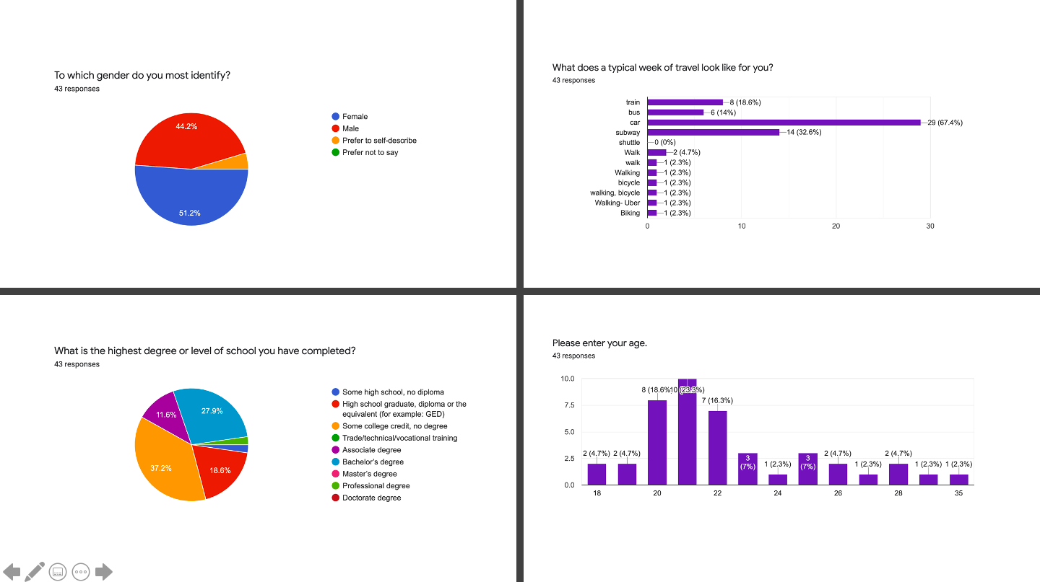

Slide 8
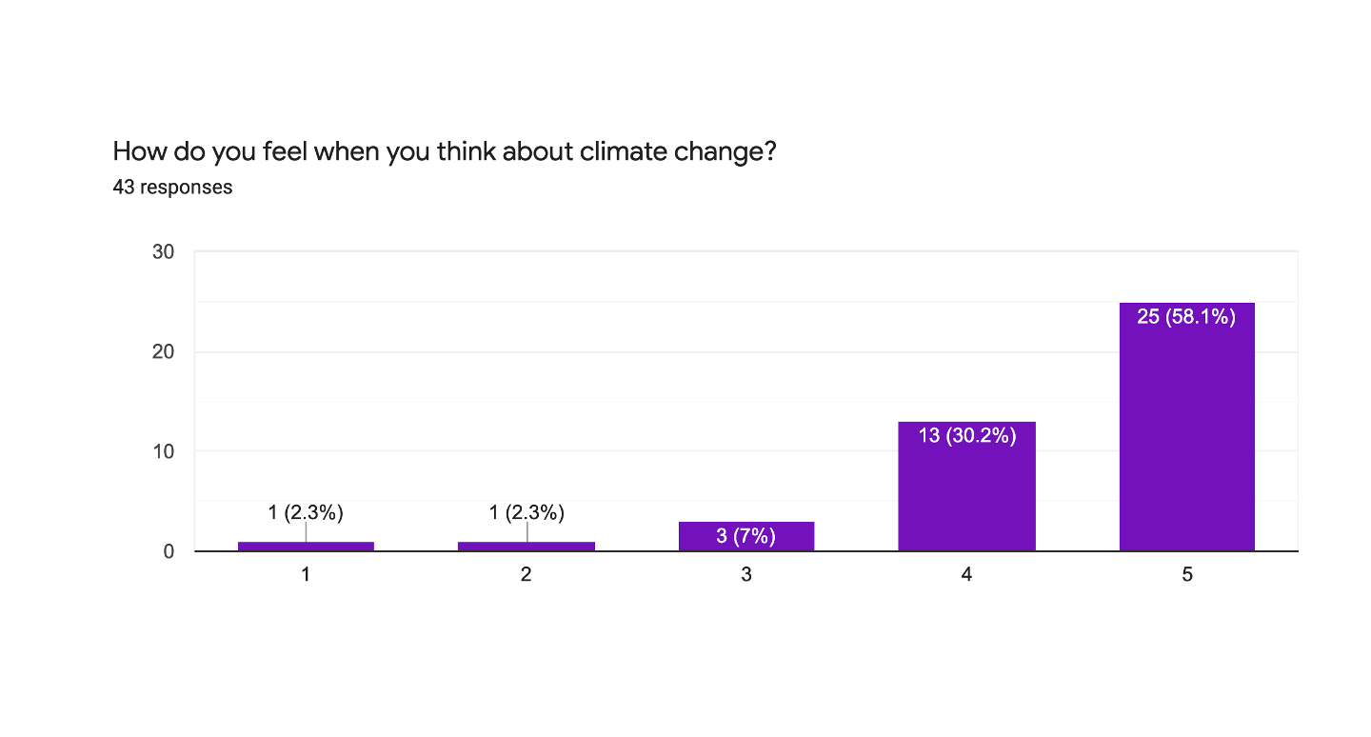

Slide 9
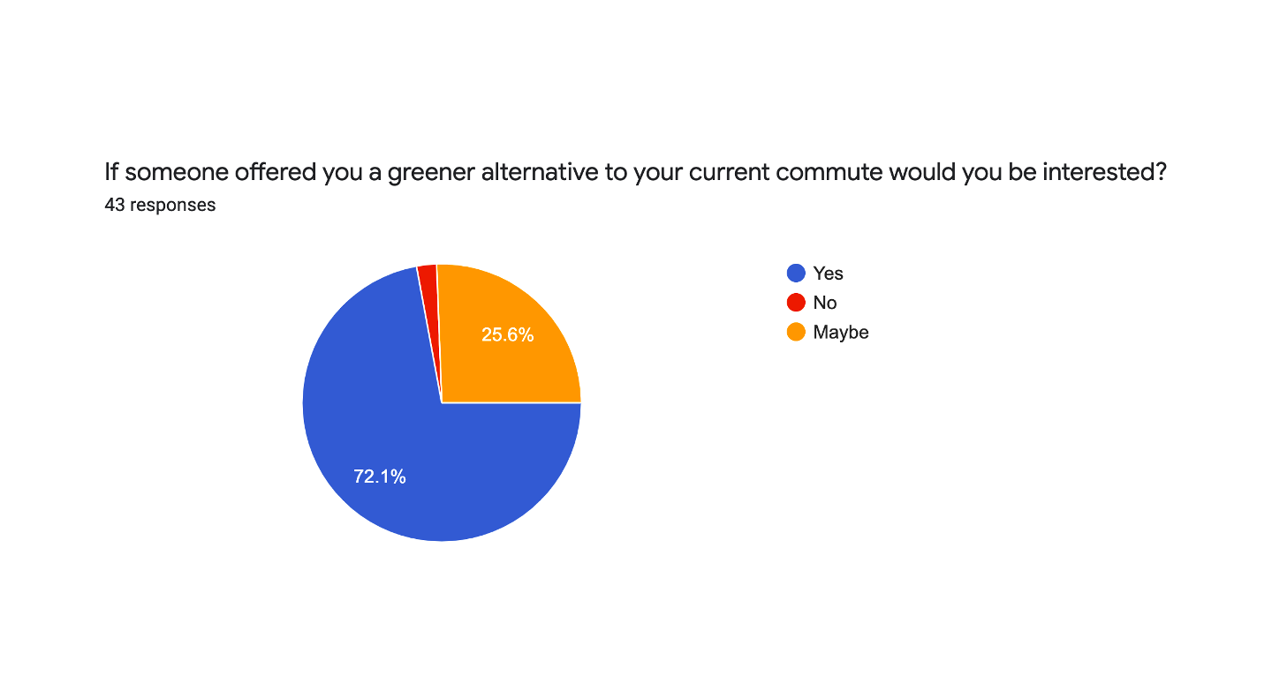

Slide 10
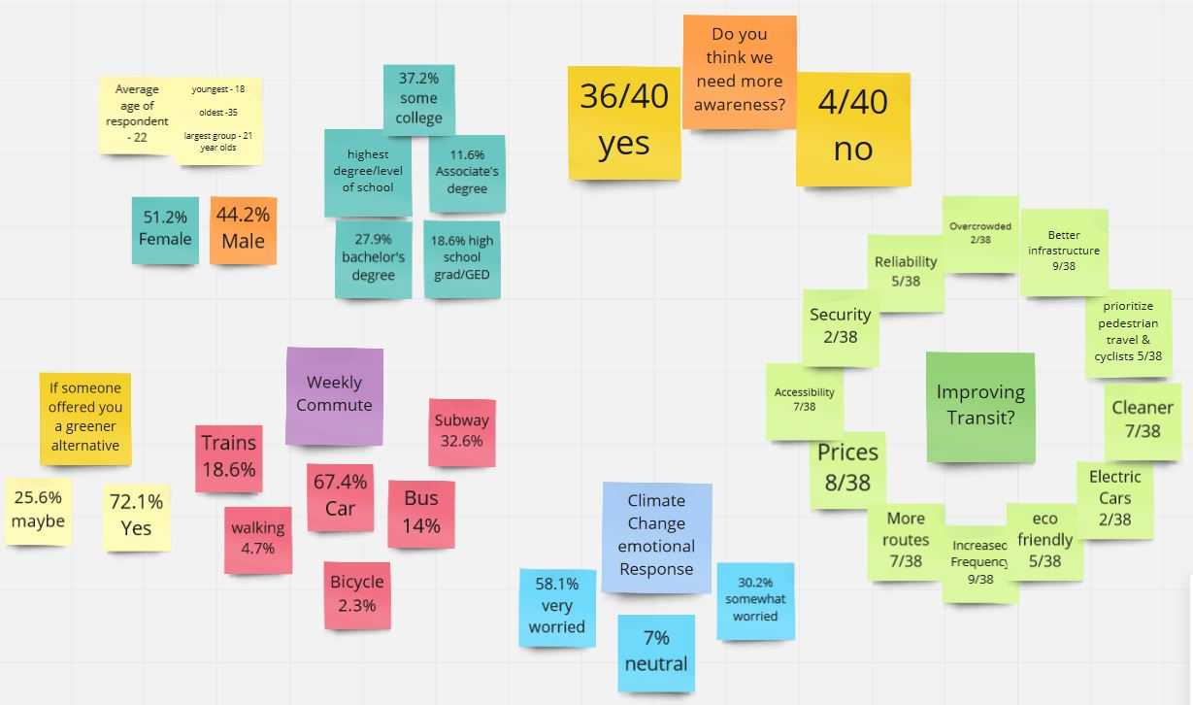

Slide 11
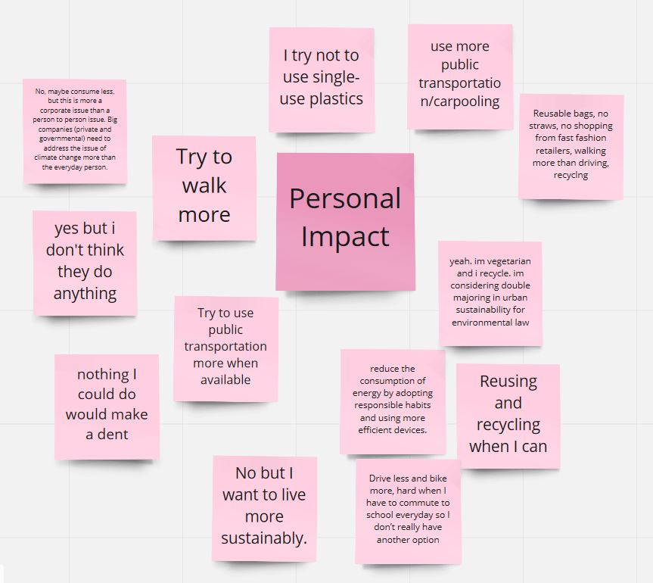

Slide 12
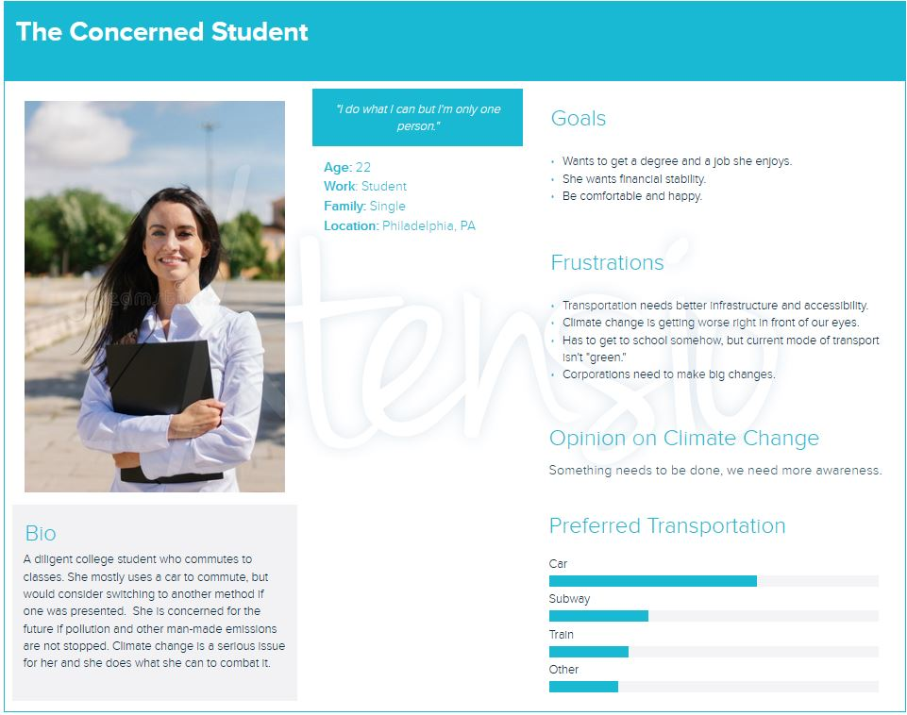

Slide 13
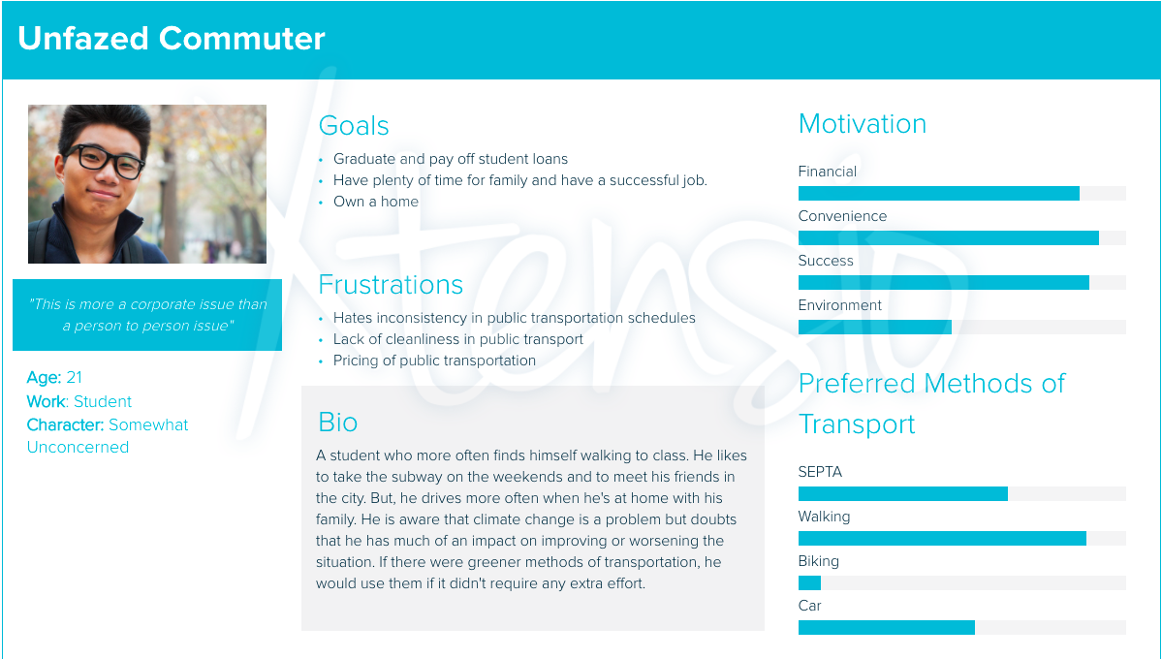

Slide 14
Insight Statements
The Concerned Student
The Unfazed Commuter
have public transportation with better infrastructure
have more convenience in travel
of the worsening conditions of climate change.
it will be more accessible.
wants to
wants to
because
because

Slide 15
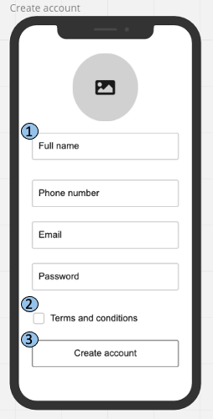
Login/Signup
Text Box: Once tapped each box allows the user to enter self-identifying information.
Radio Button: Tap agree to terms and conditions
Submit Button: Tap create account button to create user profile and move to home page.

Slide 16
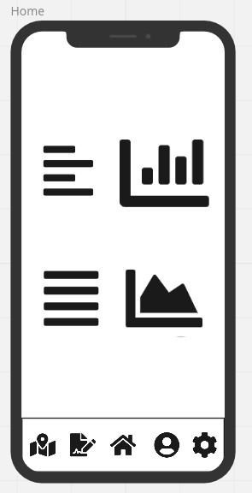





Home
Graphs: The user is directed to the homepage after logging in. The page contains statistics regarding pollution and climate change.
Navbar: Contains paths to each page. The user will be directed to each corresponding page
Paths
Reports
Home
Profile
Settings.
If user has already created an account they will be automatically directed to this page.

Slide 17
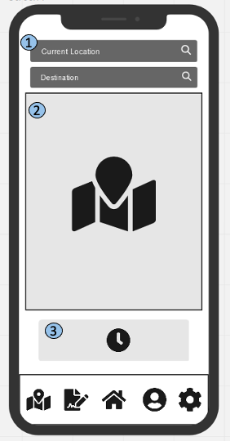
Paths
Search Bar: The user taps the search bar to enter their starting address and destination address.
Map: The map will display paths that are sorted based on their pollution output.
Schedule Button: The schedule button when tapped will bring the user to schedules page.

Slide 18
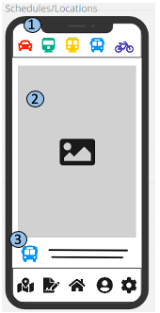
Paths - Schedule
1. Mode of Transport:
Car icon: Click on icon to find carpool options.
Train icon: Click on icon to find arrival times.
Bus icon: Click on icon to find arrival times.
Subway icon: Click on icon to find arrival times.
Bicycle icon: Click on icon to find bike stands
2. Displays locations or schedules for mode of transport.
3. Identifies the mode of transportation that the user is currently viewing.

Slide 19
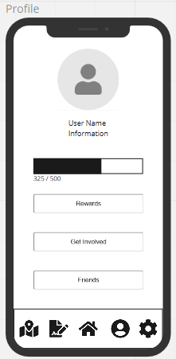



Profile
Profile Information: The user’s name and photo is displayed.
Rewards Bar: The user can view their rewards bar to keep track of their points.
Rewards Button: Click on this button to take user to rewards page.
Get Involved Button: Click on this button to take user to find volunteer opportunities.
Friends Button: Click on this button to take user to list of friends.

Slide 20
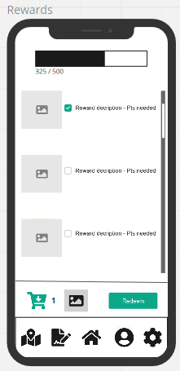
Profile - Rewards
Rewards Bar: The user can view their rewards bar to keep track of their points.
Reward Icon: Displays a depiction of the reward.
Reward Information: Displays what the reward entails as well as how many points are needed, with a checkbox for if you’d like to select this reward to be redeemed.
Cart: Displays current rewards selected for redemption as well as how many points you will be left with.
Redeem button: Allows the user to claim the reward for future use.
1
2
3
4
5

Slide 21
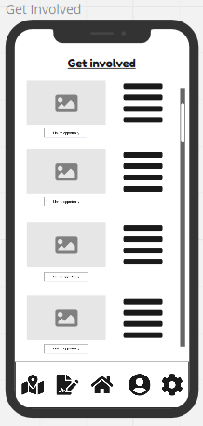
Profile - Get Involved
Opportunity Picture: Depicts what the organization or group would like to display to attract users to join the cause or event.
Opportunity Description: Describes what the organization or group would be doing and how the user can get involved. As well as lists an amount of points the user would receive if they are being offered.
Opportunity Button: Allows the user to tap to learn more about the opportunity and get in contact with the organization or group via a link.
1
2
3

Slide 22
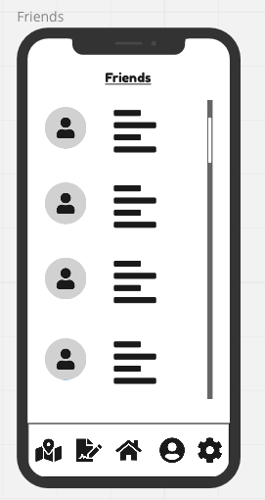
Profile - Friends
Friend Icon: A display of the other users choosing to show either their face or a picture they enjoy.
Friend Information: Displays ways to contact the friend as well as any other information they would like to display.
1
2

Slide 23
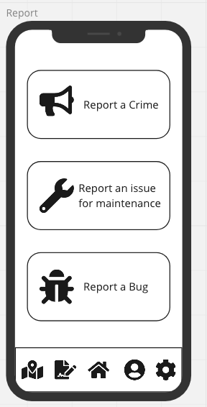
Report
Crime Button: Allows the user to tap to report something they witnessed on public transit (NOT a replacement for 911). Their report will be sent to the appropriate authorities.
Maintenance Button: Allows the user to tap to report something they witnessed on public transit. The report is sent to that transits maintenance team.
Bug Button: Allows the user to tap to report an issue with the app. The report is sent to app developers for review.
1
2
3

Slide 24
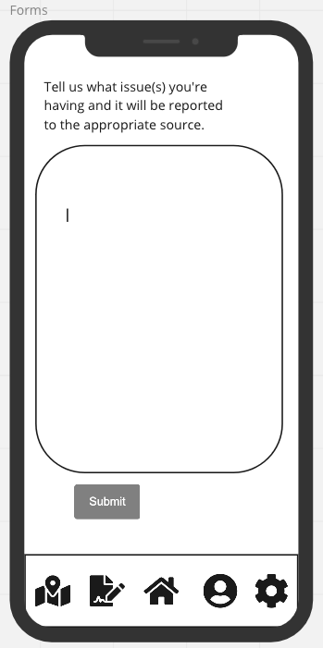
Report - Report Prompt
1
Report Prompt: Allows the user to link a picture as well as offers a prompt to type what they saw on public transit.
Submit Button: Allows the user to send this report to the appropriate place according to the report option selected earlier.
2

Slide 25
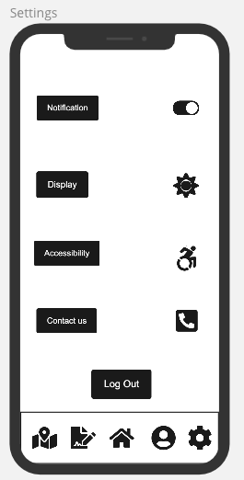




Settings
Notification toggle on/off: allows the user to choose whether they want to be notified by the app or not.
Display Button: Allows the user to select all they display options for example dark/light modes and ect...
Accessibility Button: Allows the user to select text size or to zoom in to help our user using the app efficiently.
Contact us Button: It has all our contact information and social media accounts in case they need to contact us.
Logout Button: Allows the user to log out from their account.

Slide 26
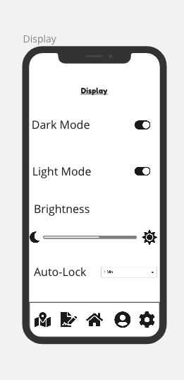
Settings - Display
Dark Mode toggle on/off: allows the user to switch to dark mode.
Light Mode toggle on/off: allows the user to switch to light mode.
Brightness Bar slide: allows the user increase or decrease the brightness of the screen.
Auto-Lock drop-down: allows the user to choose the time for auto-locking the screen.

Slide 27
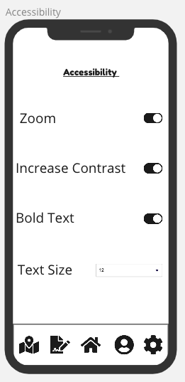
Settings - Accessibility
Zoom toggle on/off: allows the user to zoom in into the screen for a better viewing.
Increase Contrast toggle on/off: when turning on it increases the brightness to its maximum limit.
Bold Text toggle on/off: allows the user to make all the text bold.
Text Size drop-down: this allows the user to choose the text size.

Slide 28
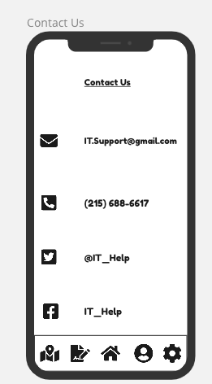
Setting- Contact Us
1- This window shows our contact information in case the user needed to contact us;
Email
Phone Number
Twitter Account
Facebook Account

